Slide 1
Lecture 6: Introduction to SQL Part 2

Slide 2
The Relational Model
Consists of three components:
Relations
Integrity Constraints
Operations
Select
Project
Cartesian Product
Join
Set operations:
Union
Intersect
Set difference

Slide 3
Set Operations
Set operations union, intersect, and except
Two tables have to be union-compatible
Each of the above operations automatically eliminates duplicates
To retain all duplicates use the corresponding multiset versions union all, intersect all and except all. Suppose a tuple occurs m times in r and n times in s, then, it occurs:
m + n times in r union all s
min(m,n) times in r intersect all s
max(0, m – n) times in r except all s

Slide 4
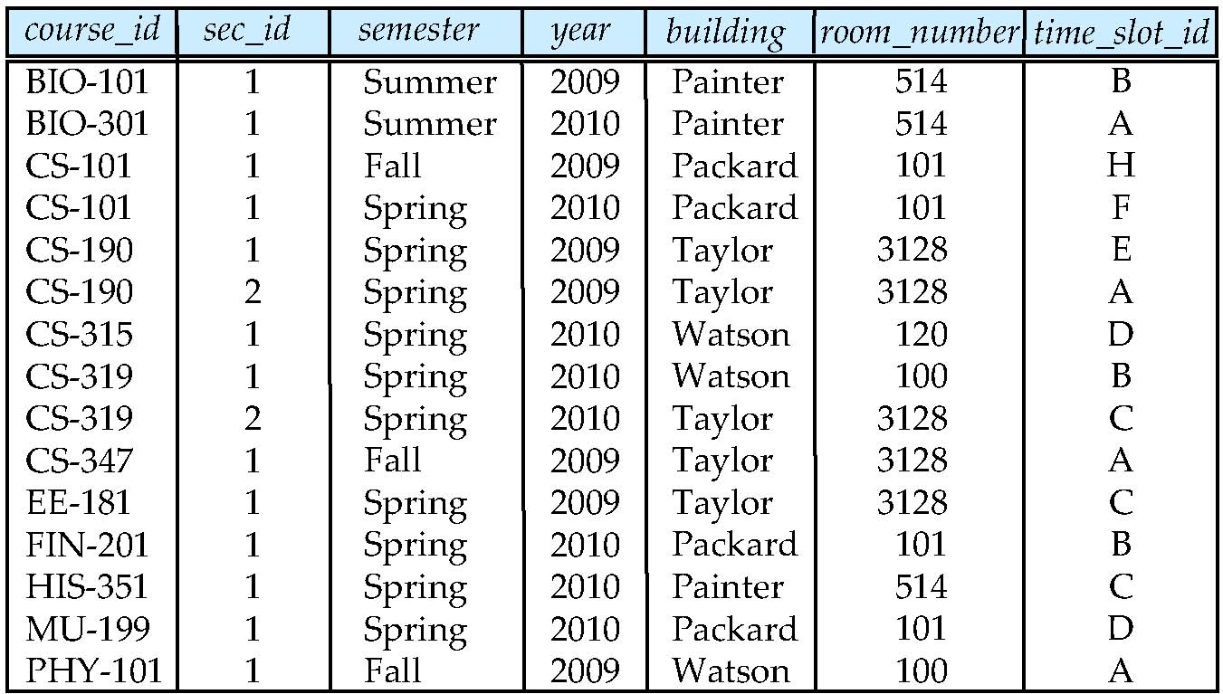
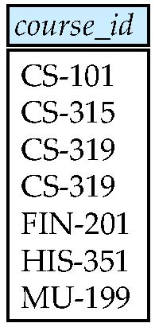
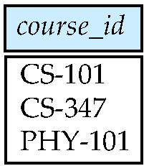
section table
Spring 2010
Fall 2009

Slide 5
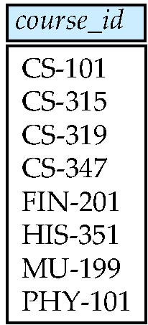
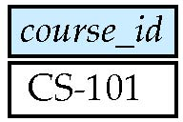
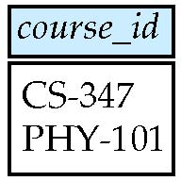
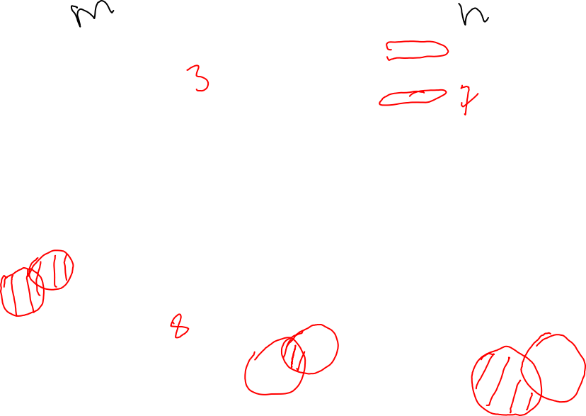
m
n
Union
m + n
Intersect
(Set Intersect)
min(m,n)
Except
(Set Difference)
max(0, m – n)

Slide 6
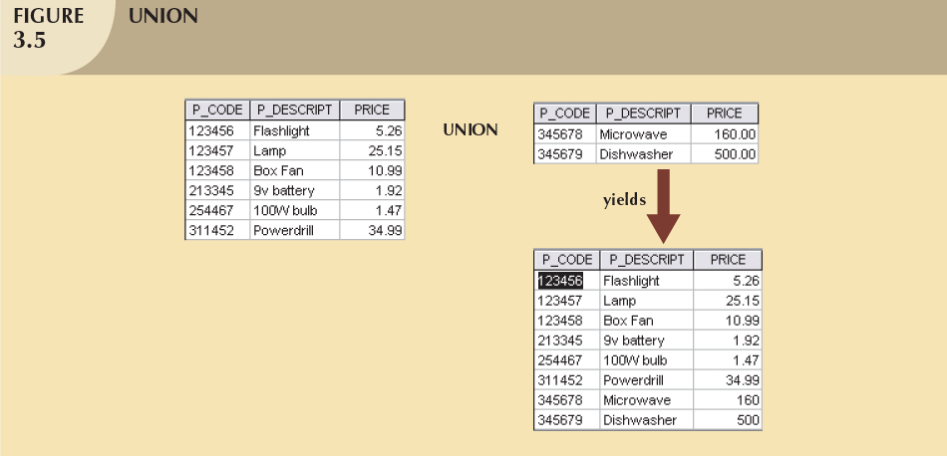

Union
Combines all rows from two tables
Union-compatible
The two input tables should have the same schema
Attributes and domains should be identical
Excludes duplicate rows

Slide 7


Example
Given the below section table, write a query to find the set of all courses taught in Fall 2009, Spring 2010, or both.

Slide 8
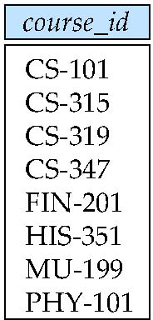
Solution using Relational Query
Find courses that ran in Fall 2009 OR in Spring 2010
∏_{course_id} (σ _{semester=“Fall” Λ year=2009} (section))
∪ ∏_{course_id} (σ _{semester=“Spring” Λ year=2010} (section))

Slide 9

Solution using SQL
Find courses that ran in Fall 2009 OR in Spring 2010
select course_id from section where semester = ‘Fall’ and year = 2009
Union
select course_id from section where semester = ‘Spring’ and year = 2010

Slide 10
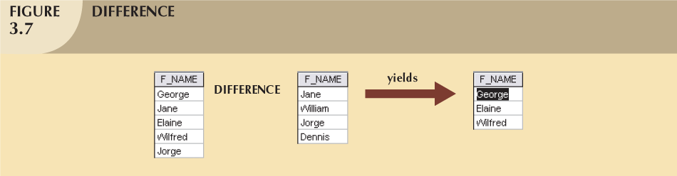
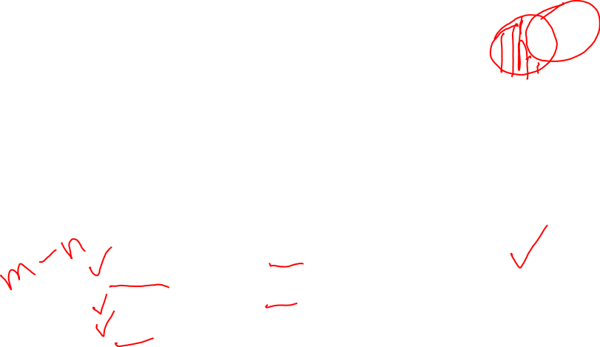
Set-difference
All rows in left table that are NOT in the right table
Input tables must be union-compatible

Slide 11
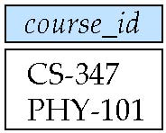

Solution using Relational Query
Find all courses that are taught in Fall 2009 but not in Spring 2010
∏_{course_id} (σ _{semester=“Fall” Λ year=2009} (section))
- ∏_{course_id} (σ _{semester=“Spring” Λ year=2010} (section))

Slide 12

Solution using SQL
Find courses that ran in Fall 2009 but not in in Spring 2010
select course_id from section where semester = ‘Fall’ and year = 2009
except
select course_id from section where semester = ‘Spring’ and year = 2010

Slide 13
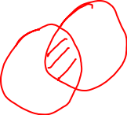
Set-Intersection
All common rows in left table AND in the right table
Input tables must be union-compatible

Slide 14

Solution using Relational Query
Find all courses that are taught in both Fall 2009 and in Spring 2010
∏_{course_id} (σ _{semester=“Fall” Λ year=2009} (section))
Ո
∏_{course_id} (σ _{semester=“Spring” Λ year=2010} (section))

Slide 15
Solution using SQL
Find courses that ran in Fall 2009 AND in Spring 2010
select course_id from section where semester = ‘Fall’ and year = 2009
intersect
select course_id from section where semester = ‘Spring’ and year = 2010

Slide 16

The Rename Operation
The SQL allows renaming relations and attributes using the as clause:
old-name as new-name
Example:
select ID, name, salary/12 as monthly_salary from instructor
Find the names of all instructors who have a higher salary than some instructor in ‘Comp. Sci’.
select distinct T. name from instructor as T, instructor as S where T.salary > S.salary
and S.dept_name = ‘Comp. Sci.’
Keyword as is optional and may be omitted instructor as T ≡ instructor T
Notes:
9

Slide 17
Nested Subqueries
SQL provides a mechanism for the nesting of subqueries.
A subquery is a select-from-where expression that is nested within another query.
A common use of subqueries is to perform tests for set membership, set comparisons, and set cardinality.

Slide 18
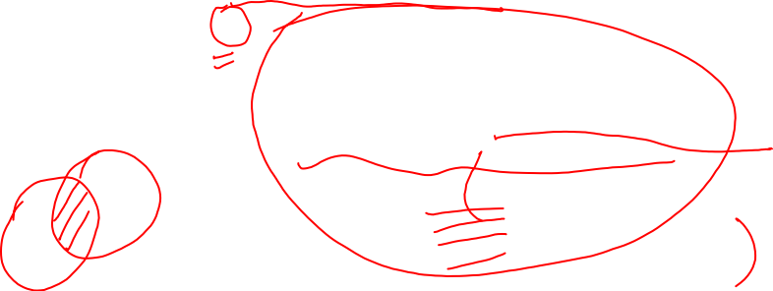
Expressing intersect using in
Find courses offered in Fall 2009 and in Spring 2010
select course_id
from section
where semester = ’Fall’ and year= 2009
and course_id in (
select course_id
from section
where semester = ’Spring’ and year= 2010);

Slide 19

Expressing except using not in
Find courses offered in Fall 2009 but not in Spring 2010
select course_id
from section
where semester = ’Fall’ and year= 2009
and course_id not in (
select course_id
from section
where semester = ’Spring’ and year= 2010);

Slide 20
Example
Find sid and sname for sailors who’ve reserved a red OR a green boat
Which Set function should we use here?

Slide 21
Find sid and sname for sailors who’ve reserved a red OR a green boat
SELECT S.sid, S.sname
FROM Sailors S, Boats B, Reserves R
WHERE S.sid=R.sid AND R.bid=B.bid AND B.color=‘red’
UNION
SELECT S.sid, S.sname
FROM Sailors S, Boats B, Reserves R
WHERE S.sid=R.sid AND R.bid=B.bid AND B.color=‘green’;
SELECT S.sid, S.sname
FROM Sailors S, Boats B, Reserves R
WHERE S.sid=R.sid AND R.bid=B.bid AND (B.color=‘red’ OR B.color=‘green’);

Slide 22
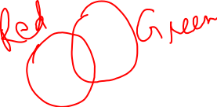
Exercise
Find sid and sname for sailors who’ve reserved a red AND a green boat

Slide 23
Find sid and sname for sailors who’ve reserved a red AND a green boat
SELECT S.sid, S.sname
FROM Sailors S, Boats B, Reserves R
WHERE S.sid=R.sid AND R.bid=B.bid AND B.color=‘red’
INTERSECT
SELECT S.sid, S.sname
FROM Sailors S, Boats B, Reserves R
WHERE S.sid=R.sid AND R.bid=B.bid AND B.color=‘green’;
Nested Subquery
SELECT S.sid, S.sname
FROM Sailors S, Boats B, Reserves R
WHERE S.sid=R.sid AND R.bid=B.bid AND B.color=‘red’
AND sid_id in (
SELECT S.sid
FROM Sailors S, Boats B, Reserves R
WHERE S.sid=R.sid AND R.bid=B.bid AND B.color=‘green’);

Slide 24

Class Exercise 1
Find sid and sname for sailors who’ve reserved a red BUT NOT a green boat

Slide 25

Find sid and sname for sailors who’ve reserved a red BUT NOT a green boat
SELECT S.sid, S.sname
FROM Sailors S, Boats B, Reserves R
WHERE S.sid=R.sid AND R.bid=B.bid AND B.color=‘red’
INTERSECT
SELECT S.sid, S.sname
FROM Sailors S, Boats B, Reserves R
WHERE S.sid=R.sid AND R.bid=B.bid AND B.color=‘green’;
Nested Subquery
SELECT S.sid, S.sname
FROM Sailors S, Boats B, Reserves R
WHERE S.sid=R.sid AND R.bid=B.bid AND B.color=‘red’
AND sid_id NOT in (
SELECT S.sid
FROM Sailors S, Boats B, Reserves R
WHERE S.sid=R.sid AND R.bid=B.bid AND B.color=‘green’);

Slide 26
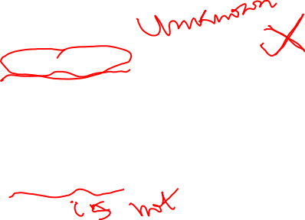
Null Values
It is possible for tuples to have a null value, denoted by null, for some of their attributes
null signifies an unknown value or that a value does not exist.
The result of any arithmetic expression involving null is null
Example: 5 + null returns null
The predicate is null can be used to check for null values.
Example: Find all instructors whose salary is null.
select name from instructor where salary = null -- Wrong!
select name from instructor where salary is null -- Correct!

Slide 27

Null Values and Three Valued Logic
Any comparison with null returns unknown
Example: 5 < null or null <> null or null = null
Three-valued logic using the truth value unknown:
OR: (unknown or true) = true, (unknown or false) = unknown (unknown or unknown) = unknown
AND: (true and unknown) = unknown, (false and unknown) = false, (unknown and unknown) = unknown
NOT: (not unknown) = unknown
“P is unknown” evaluates to true if predicate P evaluates to unknown
Result of where clause predicate is treated as false if it evaluates to unknown

Slide 28

Examples of using Null Values
select *
from department
where budget is null
select *
from department
where budget > 9000
and budget is not null

Slide 29
The distinct keyword
The distinct key word is used to remove duplicates.
select distinct dept_name from instructor

Slide 30
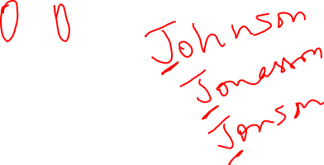
String Operations
SQL includes a string-matching operator for comparisons on character strings. The operator “like” uses patterns that are described using two special characters:
percent (%). The % character matches any substring.
underscore (_). The _ character matches any character.
Find the names of all instructors whose name includes the substring “ing”. select name from instructor where name like ‘%ing%'

Slide 31
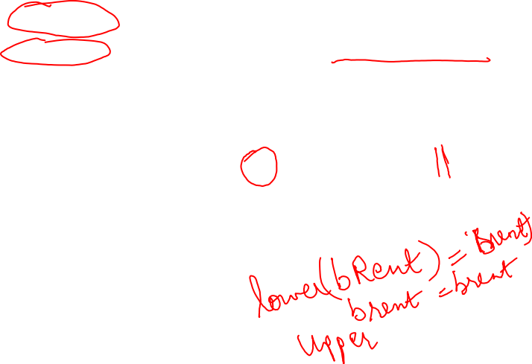
String Operations (continued)
Patterns are case sensitive.
Pattern matching examples:
‘Intro%’ matches any string beginning with “Intro”.
‘%Comp%’ matches any string containing “Comp” as a substring.
‘_ _ _’ matches any string of exactly three characters.
‘_ _ _ %’ matches any string of at least three characters.
SQL supports a variety of string operations such as
select CONCAT(name,’,‘,dept_name)
from instructor
converting from upper to lower case (and vice versa)
select lower(dept_name)
from instructor

Slide 32

Ordering the Display of Tuples
List in alphabetic order the names of all instructors select distinct name from instructor order by name
We may specify desc for descending order or asc for ascending order, for each attribute; ascending order is the default.
Example: order by name desc
Can sort on multiple attributes
Example: order by dept_name, name

Slide 33
Where Clause Predicates: between
SQL includes a between comparison operator
Example: Find the names of all instructors with salary between $90,000 and $100,000 (that is, ≥ $90,000 and ≤ $100,000)
select name from instructor where salary between 90000 and 100000
Notes:
7

Slide 34
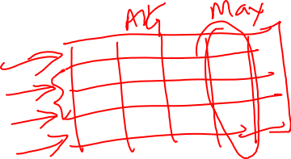
Aggregate Functions
These functions operate on the multiset of values of a column of a relation, and return a value
avg: average value min: minimum value max: maximum value sum: sum of values count: number of values

Slide 35

Aggregate Operators
SELECT COUNT (*)
FROM Sailors S
COUNT (*)
COUNT ( [DISTINCT] A)
SUM ( [DISTINCT] A)
AVG ( [DISTINCT] A)
MAX (A)
MIN (A)
SELECT AVG (S.age)
FROM Sailors S
WHERE S.rating=10
SELECT AVG ( DISTINCT S.age)
FROM Sailors S
WHERE S.rating=10
Sailors
SELECT COUNT (DISTINCT S.rating)
FROM Sailors S
WHERE S.sname=‘Bob’
SELECT MAX (S.age)
FROM Sailors S

Slide 36
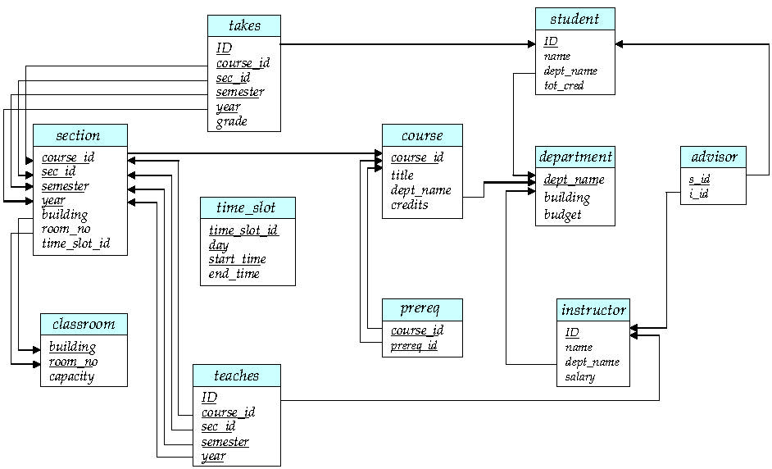
Schema Diagram for University Database

Slide 37
Class Exercise 2
Find the average salary of instructors in the Computer Science department
select avg (salary) from instructor where dept_name= ’Comp. Sci.’;
Find the total number of unique instructors who teach a course in the Spring 2010 semester
select count(distinct ID) from teaches where semester = ’Spring’ and year = 2010
Find the number for courses starting with ‘CS’ in the course relation
select count (*) from course where course_id like ‘CS%’;

Slide 38
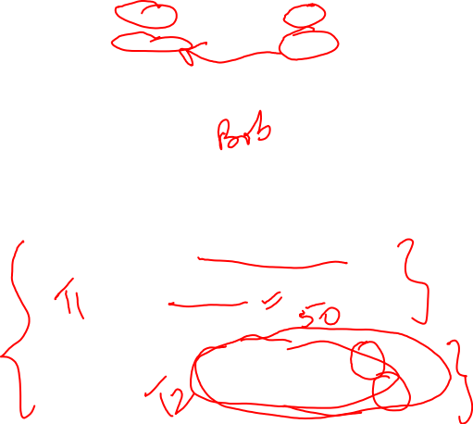
Find name and age of the oldest sailor(s)
Sailors
This query is incorrect – it produces incorrect answer! Why?
(We’ll look into the reason a bit later, when we discuss GROUP BY)
Correct way will be…..
SELECT S.sname, MAX (S.age)
FROM Sailors S
SELECT S.sname, S.age
FROM Sailors S
WHERE S.age =
(SELECT MAX (S2.age)
FROM Sailors S2)

Slide 39
Motivation for Grouping
So far, we’ve applied aggregate operators to all (qualifying) tuples. Sometimes, we want to apply them to each of several groups of tuples.
Consider: Find the age of the youngest sailor for each rating level.
Suppose we know that rating values go from 1 to 10; we can write 10 queries that look like this (!):
In general, we don’t know how many rating levels exist, and what the rating values for these levels are!
SELECT MIN (S.age)
FROM Sailors S
WHERE S.rating = i
For i = 1, 2, ... , 10:

Slide 40
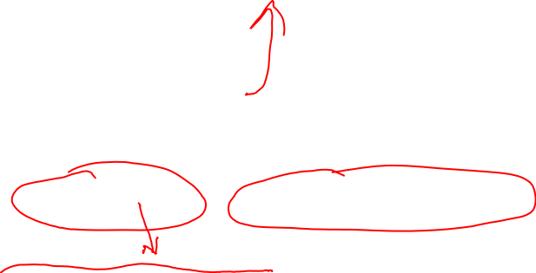
Queries With group by and having
SELECT [DISTINCT] target-list
FROM relation-list
WHERE qualification
GROUP BY grouping-list
HAVING group-qualification
The target-list contains (i) attribute names (ii) terms with aggregate operations (e.g., MIN (S.age)).
The attribute list must be a subset of grouping-list. Intuitively, each answer tuple corresponds to a group, and these attributes must have a single value per group. (A group is a set of tuples that have the same value for all attributes in grouping-list.)

Slide 41
Conceptual Evaluation
Compute the cross-product of relation-list.
Discard resulting tuples if they fail qualifications.
Delete attributes that are not in target-list.
The remaining tuples are partitioned into groups by the value of attributes in grouping-list.
The group-qualification is applied to eliminate some groups.
One answer tuple is generated per qualifying group.
If DISTINCT is specified, eliminate duplicate rows.

Slide 42
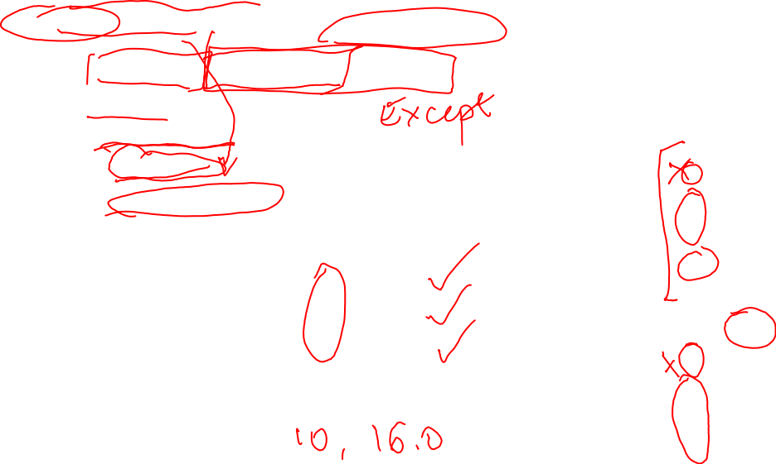
Find age and rating of the youngest sailor with age >= 18, for each rating with at least 2 such sailors
SELECT S.rating, MIN (S.age) AS minage
FROM Sailors S
WHERE S.age >= 18
GROUP BY S.rating
HAVING COUNT (*) > 1
Sailors instance:
Answer relation:
What if we do not have the condition age >=18
What if we only need name instead of rating

Slide 43
Find age of the youngest sailor with age >= 18, for each rating with at least 2 such sailors.

Slide 44
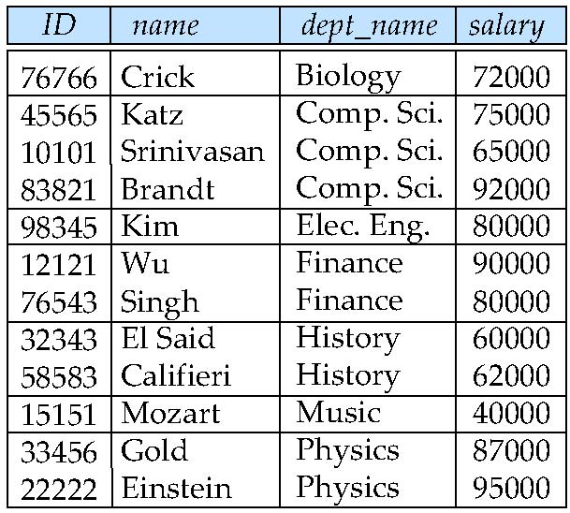
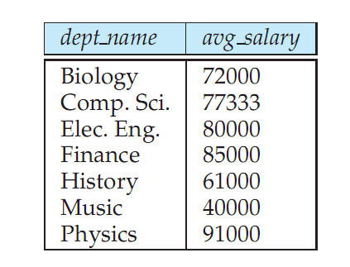
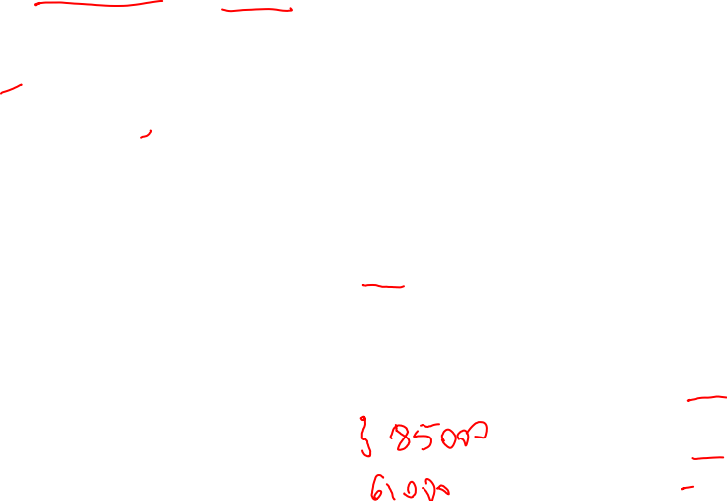
Find the dept name and average salary of instructors in each department
select dept_name, avg (salary) from instructor group by dept_name;
Note: departments with no instructor will not appear in result

Slide 45
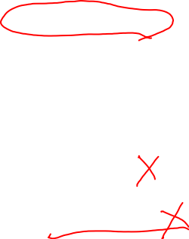
Aggregation (continued)
Attributes in select clause outside of aggregate functions must appear in group by list
/* erroneous query – may produce incorrect result */ select dept_name, ID, avg (salary) from instructor group by dept_name;
/* Correct query */ select dept_name, ID, avg (salary) from instructor group by dept_name, ID;

Slide 46
Aggregate Functions – Having Clause
Find the names and average salaries of all departments whose average salary is greater than 42000
select dept_name, avg (salary)
from instructor
group by dept_name
having avg (salary) > 42000;
Note: predicates in the having clause are applied after the formation of groups whereas predicates in the where clause are applied before forming groups

Slide 47
Null Values and Aggregates
Total all salaries
select sum (salary ) from instructor
Above statement ignores null amounts
Result is null if there is no non-null amount
All aggregate operations except count(*) ignore tuples with null values on the aggregated attributes
What if collection has only null values?
count returns 0
all other aggregates return null

Slide 48
Nested Subqueries
Used to perform tests for set memberships, set comparisons, determine set cardinality
Query used in where and from clauses
Query within query

Slide 49
Set Membership
in operator can be used to test set membership.
select distinct name
from instructor
where name in (‘Mozart’,Einstein’)
select distinct name
from instructor
where name not in (‘Mozart’,Einstein’)

Slide 50

Set Comparison
Find names of instructors with salary greater than that of some (at least one) instructor in the History department.
select T.name
from instructor T, instructor S
where T.salary > S.salary
and S.dept_name = ‘History’;
Same query using > some clause
select name
from instructor
where salary > some (or any) (select salary
from instructor
where dept_name = ‘History’);

Slide 51
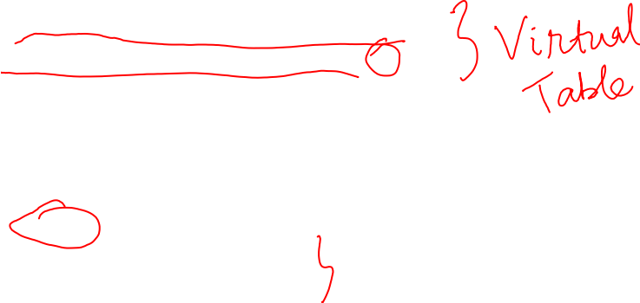
Subqueries in From Clause
Find average instructor salaries of departments where average salary is greater than $42000
Note: There is no avg_salary attribute in department or instructor tables? How do we find it?
select S.dept_name, S.avg_salary
from (select dept_name, avg(salary) as avg_salary
from instructor group by dept_name) S
where S.avg_salary > 42000;
This is equivalent to:
select S.dept_name, S.avg_salary
from S
where S.avg_salary > 42000;

Slide 52
Subqueries in Where Clause
Find the names of all instructors whose salary is greater than the salary of all instructors in the History department.
id | name | dept_name | salary
10101 | Srinivasan | Comp. Sci. | 65000
12121 | Wu | Finance | 90000
15151 | Mozart | Music | 40000
22222 | Einstein | Physics | 95000
32343 | El Said | History | 60000
33456 | Gold | Physics | 87000
45565 | Katz | Comp. Sci. | 75000
58583 | Califieri | History | 62000
76543 | Singh | Finance | 80000
76766 | Crick | Biology | 72000
83821 | Brandt | Comp. Sci. | 92000
98345 | Kim | Elec. Eng. | 80000

Slide 53

Query within query
Find Title and credits for courses taught by instructors from computer science department
Using natural join
select name, title
from instructor natural join teaches, course
where teaches.course_id = course.course_id
And dept_name = ‘Comp. Sci.’;

Slide 54
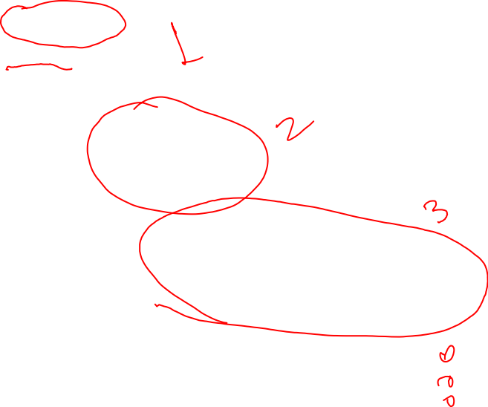
Query within query
Find Title and credits for courses taught by instructors from computer science department
select title, credits
from course
where course_id in
(select course_id
from teaches
where id in
(select id
from instructor
where dept_name = 'Comp. Sci.’));

Slide 55
Modification of the Database – Deletion
Delete all instructors
delete from instructor
Delete all instructors from the Finance department delete from instructor where dept_name= ’Finance’;
Delete all tuples in the instructor relation for those instructors associated with a department located in the Watson building.
delete from instructor where dept_name in (select dept_name from department where building = ’Watson’);

Slide 56
Deletion (continued)
Delete all instructors whose salary is less than the average salary of instructors
delete from instructor
where salary < (select avg (salary) from instructor);
Problem: as we delete tuples from deposit, the average salary changes
Solution used in SQL:
1. First, compute avg salary and find all tuples to delete
2. Next, delete all tuples found above (without recomputing avg or retesting the tuples)

Slide 57
Modification of the Database – Insertion
Add all instructors to the student relation with tot_creds set to 0 as a starting value:
insert into student select ID, name, dept_name, 0 from instructor
Question: What value will be inserted for column tot_cred if no value is specified?
insert into student select ID, name, dept_name ,???? from instructor

Slide 58
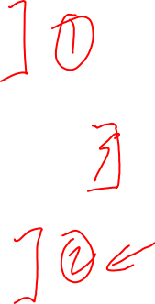
Modification of the Database – Updates
Increase salaries of instructors whose salary is over $100,000 by 3%, and all others receive a 5% raise
Write two update statements:
Step 1 update instructor set salary = salary * 1.03 where salary > 100000; OR
update instructor set salary = salary + salary * 0.03 where salary > 100000;
Step 2 update instructor set salary = salary * 1.05 where salary <= 100000;
The order of steps is important for this problem. Why?

Slide 59
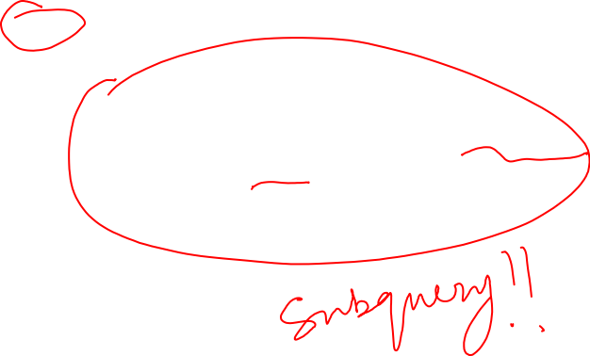
Modification of the Database – Updates
Increase salaries of instructors whose salary is over $100,000 by 3%, and all others receive a 5% raise
Using case
update instructor set salary = case
when salary <= 100000 then salary * 1.05 else salary * 1.03 end;

Slide 60
Definition of Some Clause
F <comp> some r ⇔ ∃ t ∈ r such that (F <comp> t ) Where <comp> can be: <, ≤, >, =, ≠
0
(5 < some
5
) = true
(read: 5 < some tuple in the relation)
6
0
(5 < some
5
) = false
0
(5 = some
) = true
5
0
(5 ≠ some
5
) = true (since 0 ≠ 5)
(= some) ≡ in
However, (≠ some) ≡ not in

Slide 61
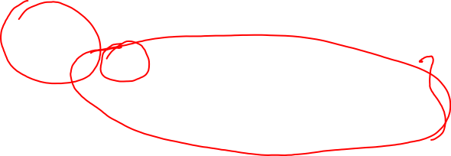
Set Comparison
Find names of instructors with salary greater than that of some (at least one) instructor in the History department.
select T.name
from instructor T, instructor S
where T.salary > S.salary and S.dept_name = ‘History’;
Same query using > some clause
select name
from instructor
where salary > some (or any) (select salary
from instructor
where dept_name = ‘History’);

Slide 62
Definition of all Clause
F <comp> all r ⇔ ∀ t ∈ r (F <comp> t)
0
(5 < all
5
) = false
6
6
(5 < all
) = true
10
4
(5 = all
) = false
5
4
(5 ≠ all
) = true (since 5 ≠ 4 and 5 ≠ 6)
6
(≠ all) ≡ not in
However, (= all) ≡ in

Slide 63
Find the names of all instructors whose salary is greater than the salary of all instructors in the History department.
select name
from instructor
where salary > all (select salary
from instructor
where dept_name = ‘History’);

Slide 64
Reading and Assignment
No. | Date | Topics and Required Reading | Assignments
 |  |  |  | start of class day

